Slide 1
HC-SR04 Ultrasonic Sonar(Distance)
Sensor

Slide 2
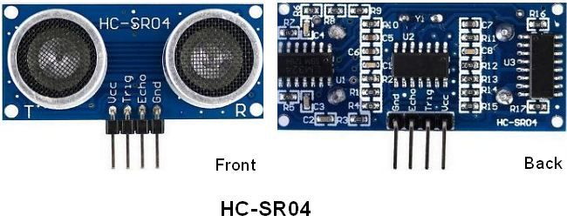
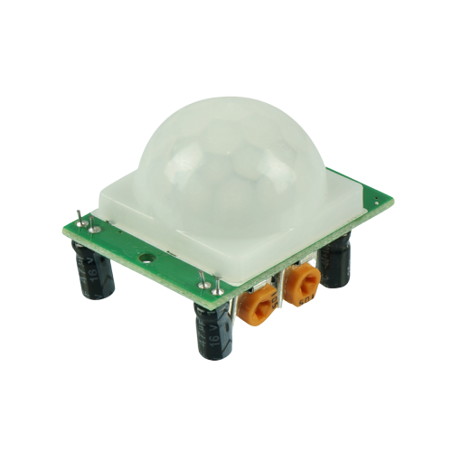
HC-SR04 Ultrasonic Sonar Sensor Front and Back

Slide 3
HC-SR04 Ultrasonic Sonar Sensor
Datasheet

Slide 4
Example
run

